Slide 1











REPORT, & STAY SAFE
STAY AWARE
Ensure a safe journey and stay informed about your surroundings with our comprehensive safety solution. By entering your starting and destination locations, you can receive a detailed analysis of crime rates along your route, identify high-risk areas, and find safer alternative paths. Our solution also includes advanced features like real-time assistance during investigations, an SOS call for help, and predictive crime zone alerts to enhance your safety and peace of mind.
D-CRIME

Slide 2
D-CRIME

Slide 3




Rising crime rates in urban areas
Due to factors like high population density, economic disparities, leading to increased theft, violence, and gang activities.
The Problem Statement We Came Across
Lack of real-time crime information for residents
Need for safe travel routes in high-crime areas
Inefficient crime reporting mechanisms
Extensive documentation problem while investigation

Slide 4


Our Solution To The Problem
1
CrimeTracker
Report crimes and gather evidence easily, geotag crime locations for accurate mapping.
2
HotSpotter
Identify and flag crime hotspots . Visual representation of hotspots on the map and helps authorities and residents stay vigilant.
3
RouteGuard
Analyzing crime rates along user-specified routes and provide detailed crime density information. Also suggest alternative routes with lower crime rates for safer travel.

Slide 5
Our Solution To The Problem
4
SOS +Location Tracker
Sends an SOS alert during emergencies and transmits the live location to the police dashboard
5
Nearby Police Ping
Identifies nearby police units to the SOS call location and assigns them for immediate response.
6
Watson RAG Bot
Watson RAG Bot retrieves historical crime data to identify patterns and assists investigators by highlighting important details during case solving.

Slide 6




HOW ROUTEGUARD WORKS?
Stage 4
Suggests alternative, safer paths
Stage 2
System analyzes crime data along the route
Stage 5
Stay Alert, Stay Safe, Keep Others Safe
Stage 3
Provides detailed crime density information
Stage 1
User inputs start and destination locationsed do eiusmod tempor incididunt

Slide 7
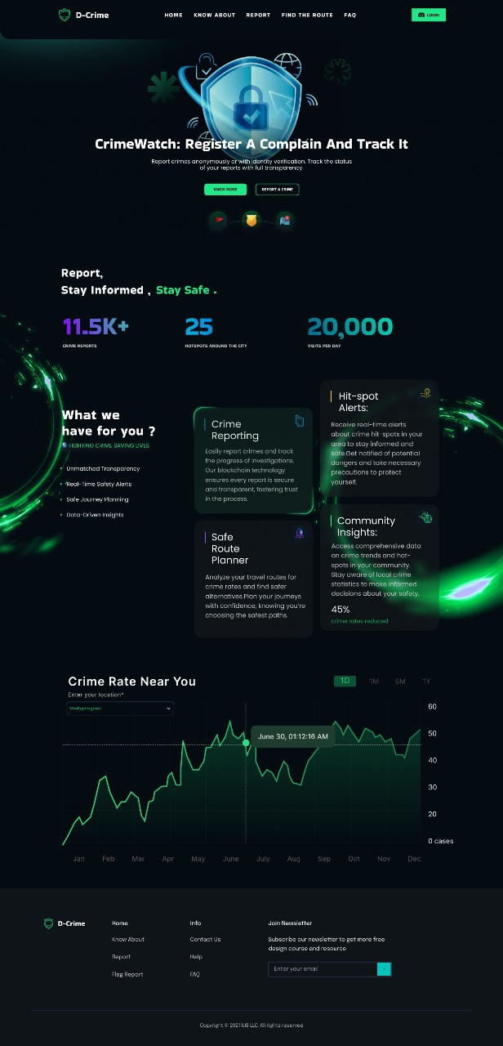
Click on the link
Let’s take a look at our UI
D-CRIME

Slide 8



Features of D-Crime
Report
Safest Path
Report anonymously.
Make the complaints immutable, morph proof
Analysing the data of crimes and calculating danger index by latitude longitude we give you the safest path between two places
Hitmap
Predictive Crime Detection
By the intensity of crime rates in a particular area, areas are flagged as hitmap for the user to understand that area is on alert.
Predicts future crime zone based on the past crime history for the police to increase its security in some predicted areas.
RAG ChatBot
SOS
Stores all case details in a digital form and acts as an assistance during case solving
After a certain number of complaints in a locality, residents get an SMS and get informed about increasing crime

Slide 9
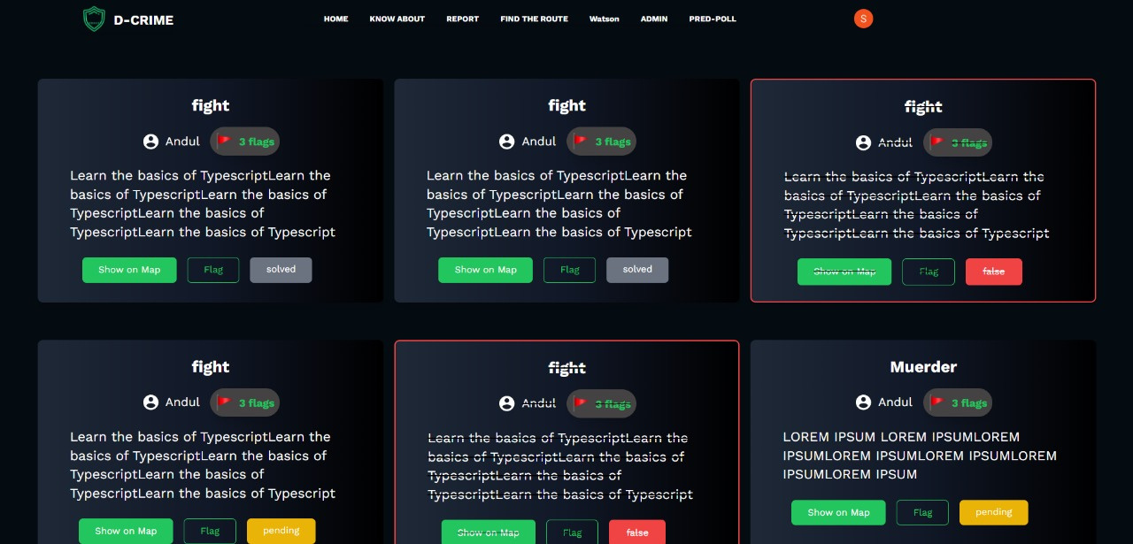
<<<<<<<Feature List
Annoynymous Report
Report anonymously.
Make the complaints immutable, morph proof to inbuild transparency and trust within community.

Slide 10
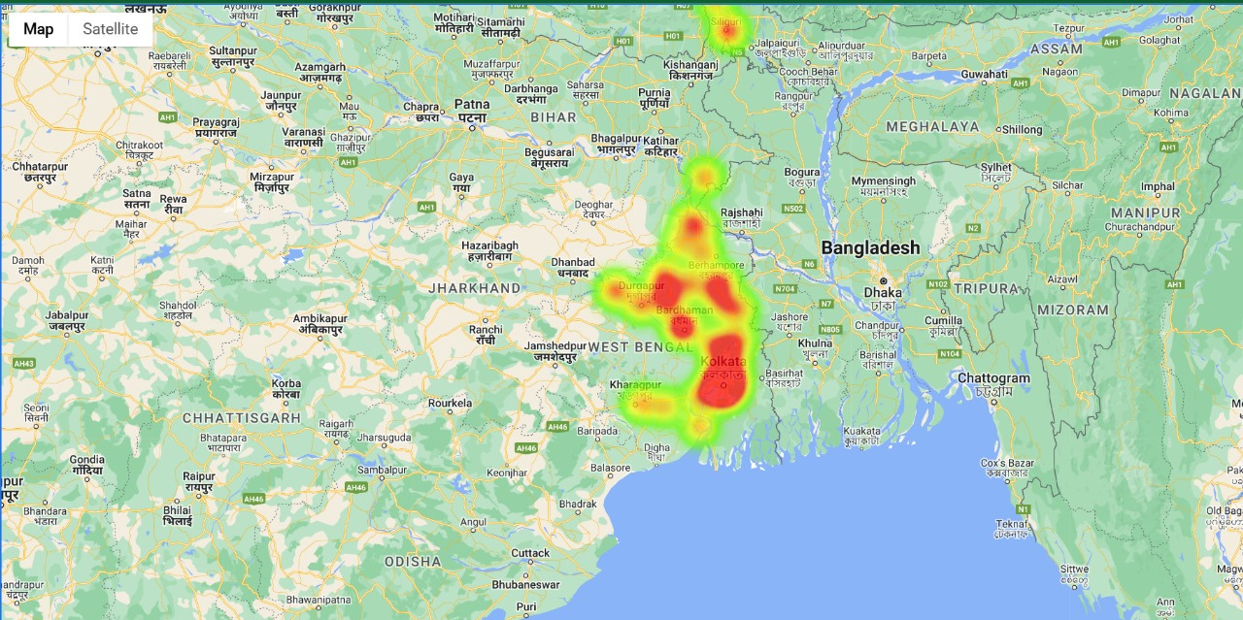
<<<<<<<Feature List
Hitmaps
By the intensity of crime rates in a particular area, areas are flagged as hitmap for the user to understand that area is on alert.
D-CRIME

Slide 11
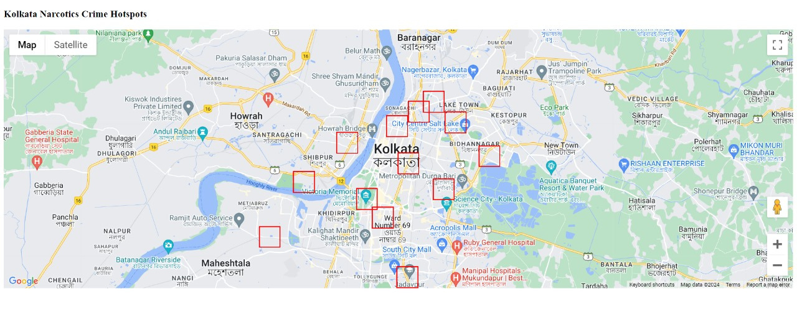
<<<<<<<Feature List
Predictive Crime Detection
Predicts future crime zone based on the past crime history for the police to increase its security in some predicted areas.
D-CRIME

Slide 12


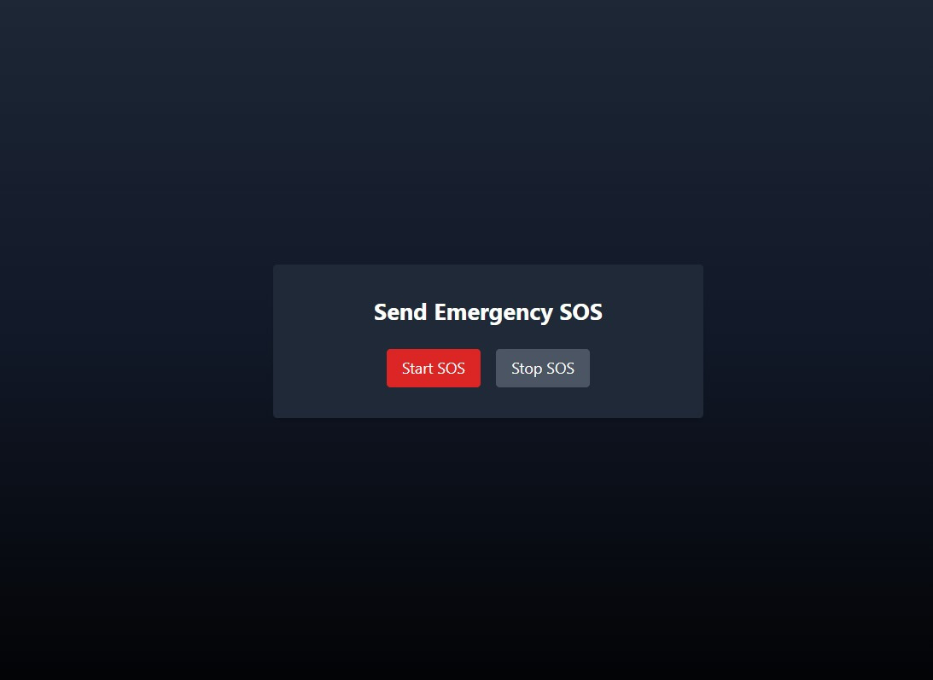
<<<<<<<Feature List
Emergency SOS Click
If an individual feels they are in danger, they can tap the SOS button once, which will automatically start sharing their live location. This location is sent directly to the admin, who can then dispatch nearby police officers for immediate rescue.
D-CRIME

Slide 13
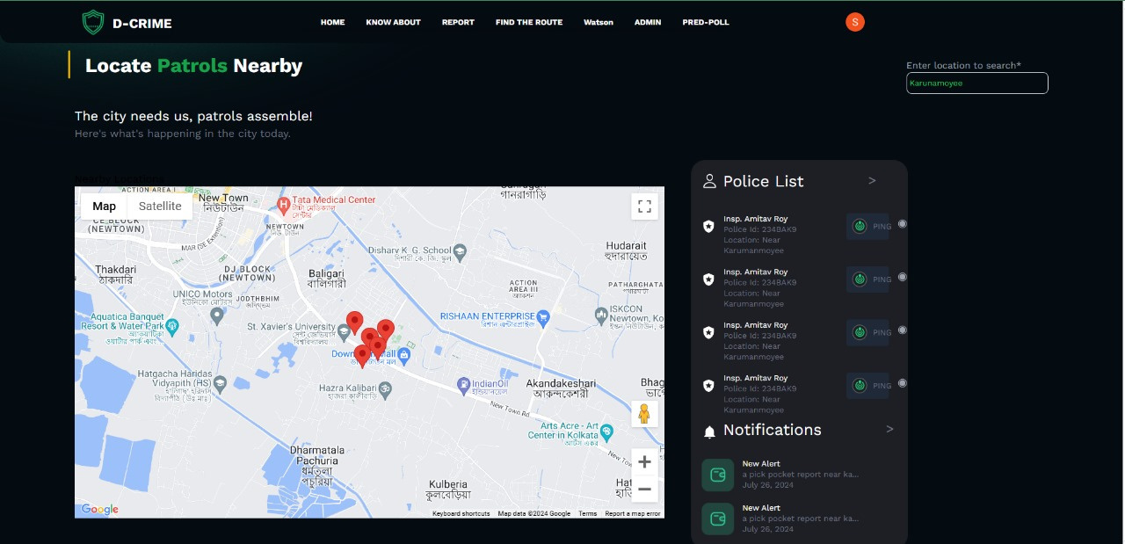
<<<<<<<Feature List
Nearby Police Ping
After an SOS complaint in a locality,the admin can ping the police personal near the SOS location to take action immediately.
D-CRIME

Slide 14
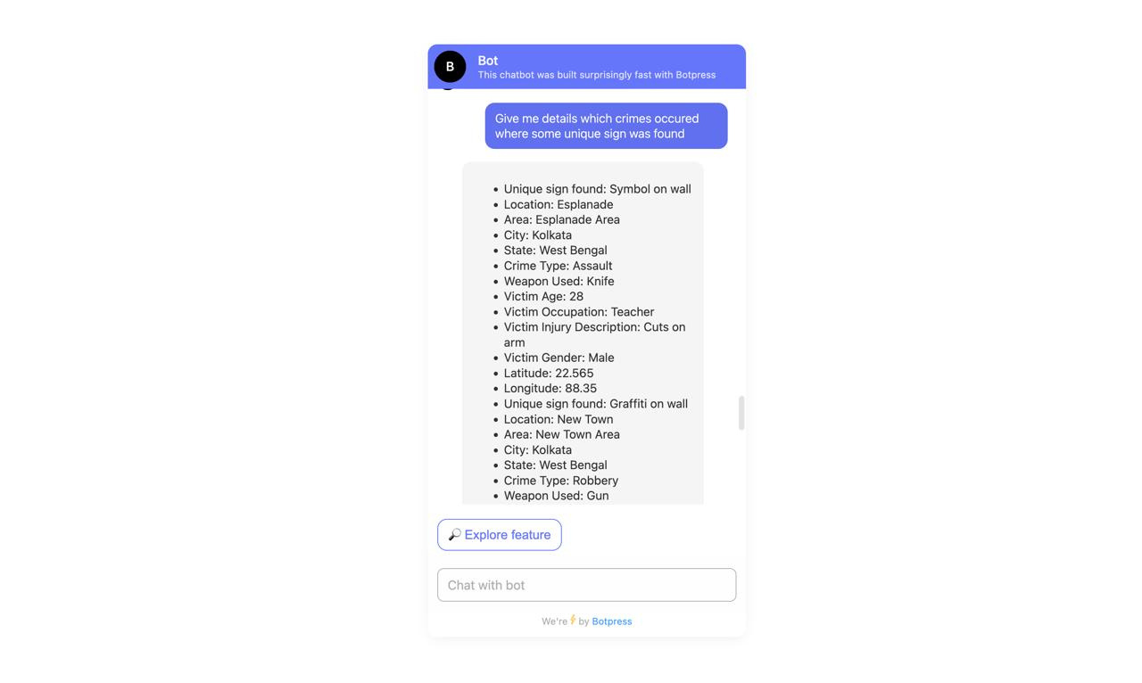
<<<<<<<Feature List
RAG Chatbot
This bot stores the previous history records and helps as an assitant during investigation to find patterns or clues.
D-CRIME

Slide 15
To store the ledger data
of the reports
a pinch of Solidity stands firm with Avalanche
MERN Stack
Python + EDA
MERN stack in its heart
handled the majority
functions keeping the architecture simple
yet sustainable
For the heatmap ,
Safest path,predictive policing.
Python’s Pandas worked
as a icing by
letting us flag the latitude longitudes with a crime/area
Solidity

Slide 16


Market chances
The Government
This will include government officials as well as law enforcement officers. We have the goal to
make this a complete working platform that aligns with government and works on reducing the
crime rates actively.
Travel and Tourism Industry
The website itself plays an important role for the tourism sector by ensuring the safety and security of the tourist by proper hit-spot locations having higher crime rates.
As API & obviously the common man
For the society itself it serves as a tool to reduce the crime rates and bind the people together in ensuring a well aware and quick functioning block overall.

Slide 17





D-CRIME
SWOT Analysis
STRENGTHS
Advanced mapping and heatmap visualization
Maintained anonymity,
Broad Market-scope
The unique safest path finder
Nearly Real-time
WEAKNESSES
Lack of Dataset
Lack of too strict of a verification algorithm
THREATS
OPPORTUNITIES
Competitors with superior datas
Public skepticism towards new technologies
Misuse of the system
Growth in Market
Regulatory support from authority
An up to date police department & aware citizens

Slide 18


THANK YOU
HOPING TO CONTRIBUTE
MAKING A BETTER SOCIETY
D-Crime

